Slide 1

Linear Regression – Part 2
Nina Gunnes
November 19, 2020

Slide 2
Confidence and prediction curves
Two types of curves associated with the regression line
  Confidence curves
  Prediction curves
Confidence curves expressing uncertainty of the placement of the line
  Movement of the line by change of intercept and slope
Prediction curves expressing limits for variation along the line
  Measure of individual deviations from the line
Analog to distinction between standard error and standard deviation

Slide 3
Example: Height and shoe size
Sex | Female | Female | Male | Female | Female | Female | Female | Female | Female | Female | Male | Male
Height | 158 | 167 | 180 | 165 | 158 | 167 | 175 | 162 | 165 | 159 | 182 | 187
Shoe size | 36 | 39 | 42.5 | 40 | 38 | 38 | 38 | 36.5 | 38.5 | 37 | 44 | 43
Sex | Male | Female | Male | Male | Female | Male | Female | Female | Female | Female | Male | Female
Height | 177 | 179.5 | 180 | 180 | 185 | 182 | 178 | 185 | 176 | 163.5 | 178 | 168
Shoe size | 41.5 | 40.5 | 44 | 45 | 41 | 42 | 42 | 41 | 40 | 37 | 42 | 38
Sex | Female | Male | Female | Male | Male | Male | Female | Female | Female | Female | Female | Female
Height | 165 | 174 | 173 | 190 | 189 | 180 | 168 | 182 | 167 | 155 | 168 | 172
Shoe size | 37 | 42 | 38 | 45.5 | 45 | 45 | 37 | 42 | 38 | 36.5 | 39.5 | 39

Slide 4
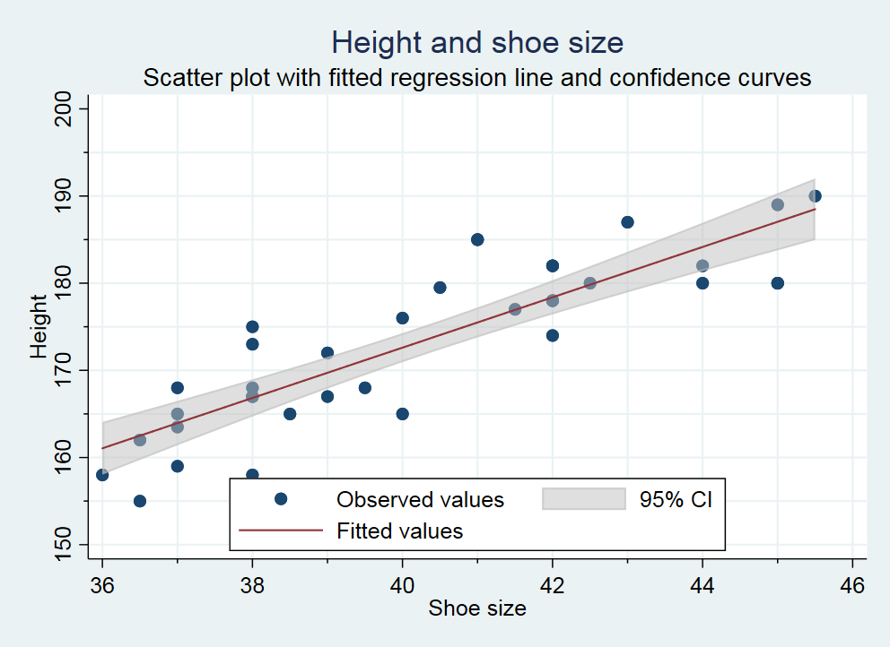
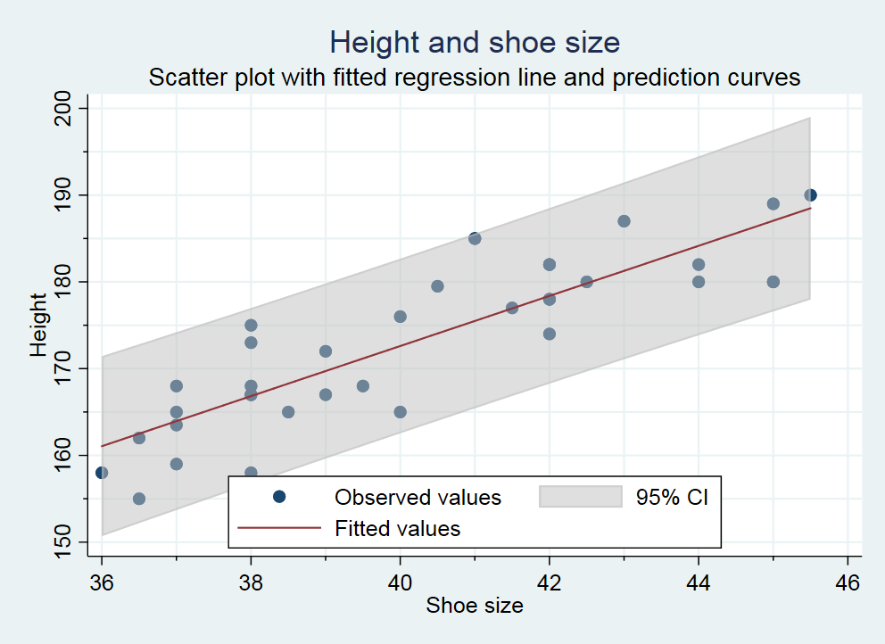
Example: Height and shoe size, cont.

Slide 5
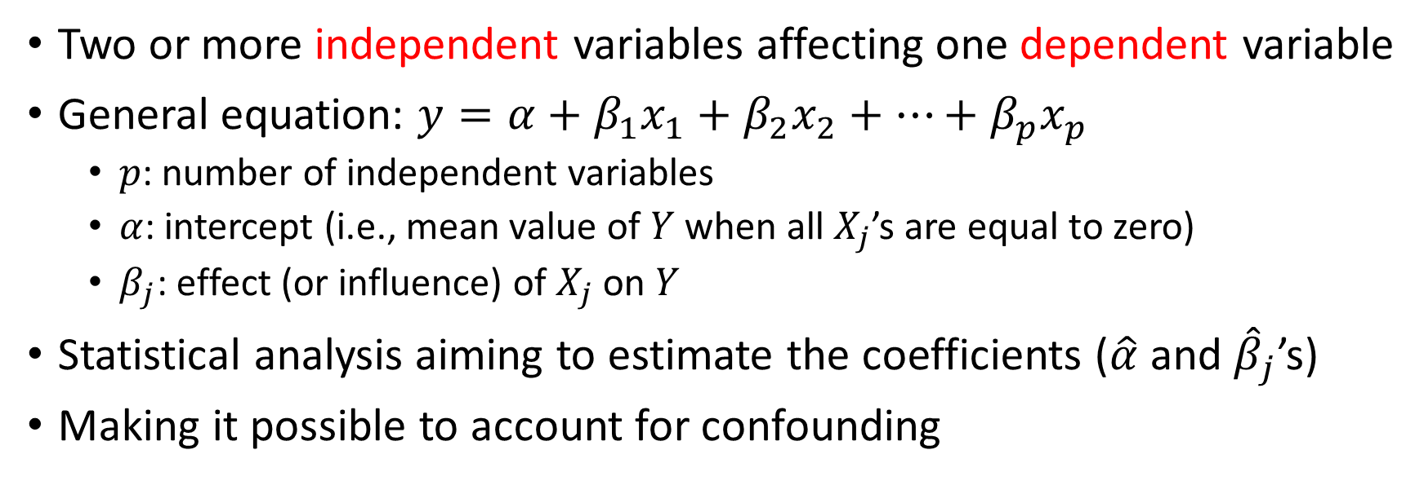
Multiple linear regression
Two or more independent variables affecting one dependent variable
General equation: $y=α+β_{1}x_{1}+β_{2}x_{2}+…+β_{p}x_{p}$
  $p$: number of independent variables
  $α$: intercept (i.e., mean value of $Y$ when all $X_{j}$’s are equal to zero)
  $β_{j}$: effect (or influence) of $X_{j}$ on $Y$
Statistical analysis aiming to estimate the coefficients ($\hat{α}$ and ${\hat{β}}_{j}$’s)
Making it possible to account for confounding

Slide 6
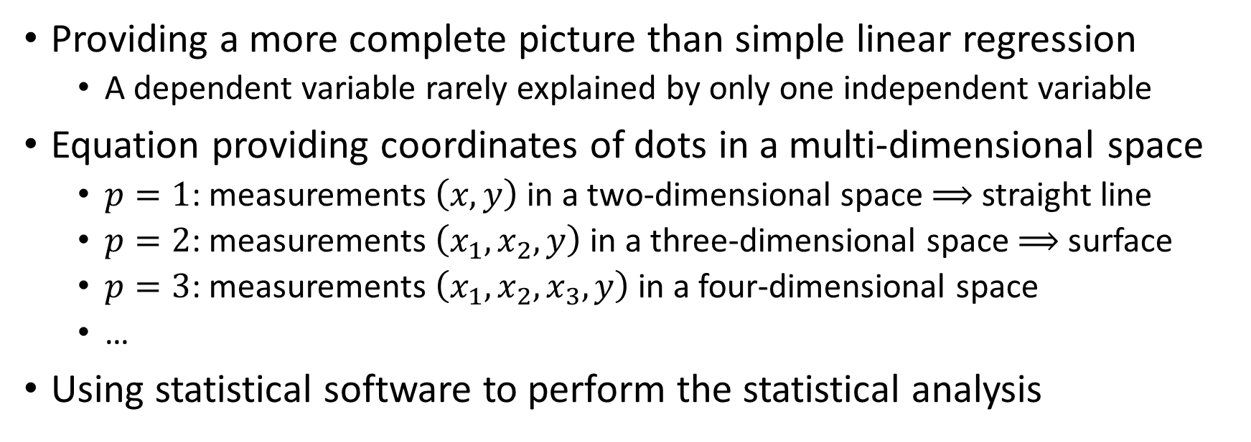
Multiple linear regression, cont.
Providing a more complete picture than simple linear regression
  A dependent variable rarely explained by only one independent variable
Equation providing coordinates of dots in a multi-dimensional space
  $p=1$: measurements $\left(x,y\right)$ in a two-dimensional space $⟹$ straight line
  $p=2$: measurements $\left(x_{1}, x_{2}, y\right)$ in a three-dimensional space $⟹$ surface
  $p=3$: measurements $\left(x_{1},x_{2},x_{3},y\right)$ in a four-dimensional space
  …
Using statistical software to perform the statistical analysis

Slide 7
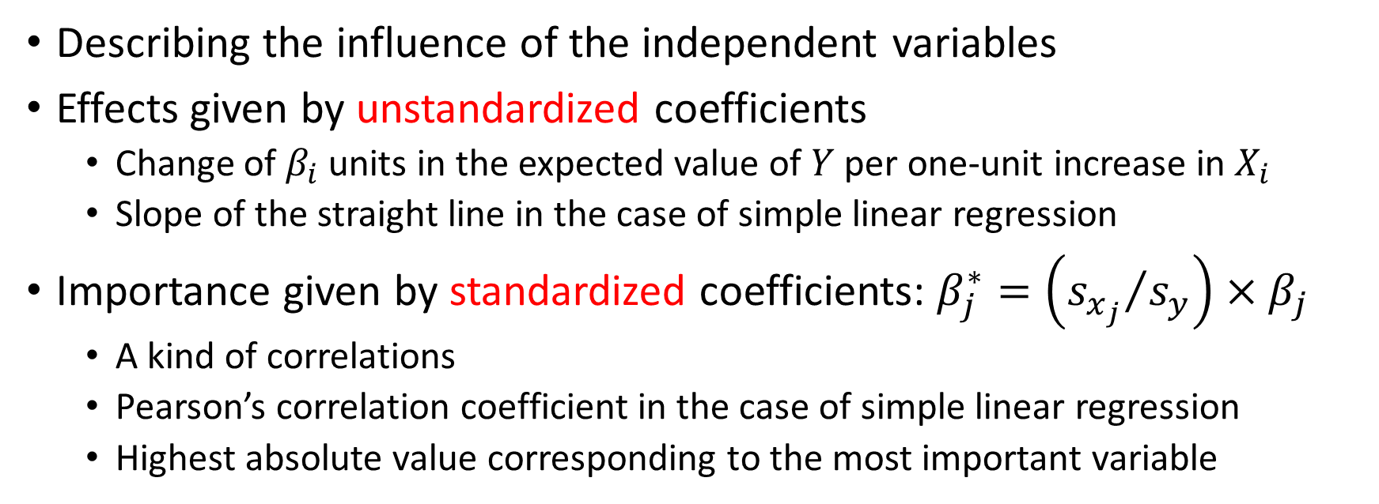
Coefficients
Describing the influence of the independent variables
Effects given by unstandardized coefficients
  Change of $β_{i}$ units in the expected value of $Y$ per one-unit increase in $X_{i}$
  Slope of the straight line in the case of simple linear regression
Importance given by standardized coefficients: $β_{j}^{∗}=\left({s_{x_{j}}}/{s_{y}}\right)×β_{j}$
  A kind of correlations
  Pearson’s correlation coefficient in the case of simple linear regression
  Highest absolute value corresponding to the most important variable

Slide 8
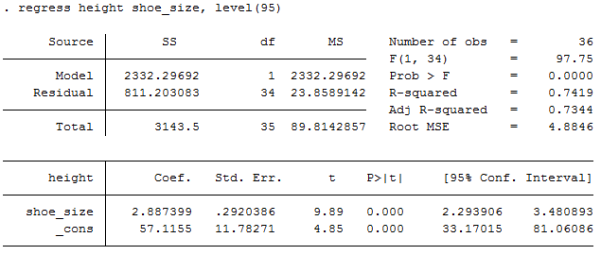

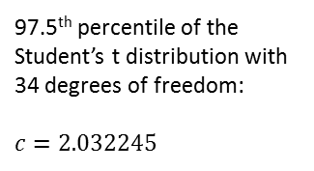

Example: Height and shoe size, cont.
97.5th percentile of the Student’s t distribution with 34 degrees of freedom:
$$c=2.032245$$
$$β$$
$$\hat{α}$$

Slide 9
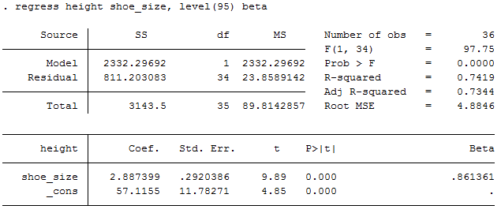

Example: Height and shoe size, cont.
$$β^{∗}=\frac{s_{x}}{s_{y}}×β$$

Slide 10
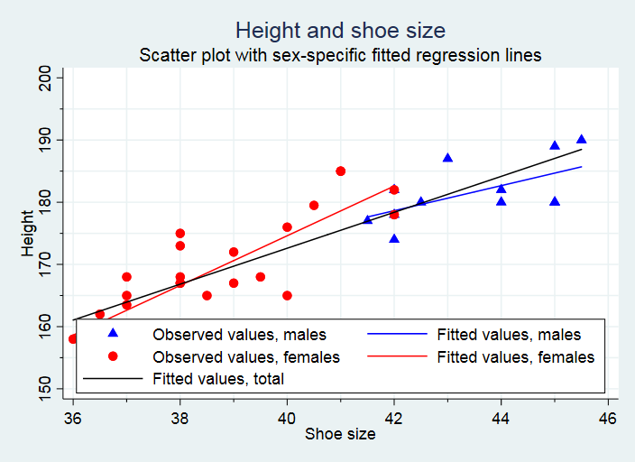
Example: Height and shoe size, cont.

Slide 11
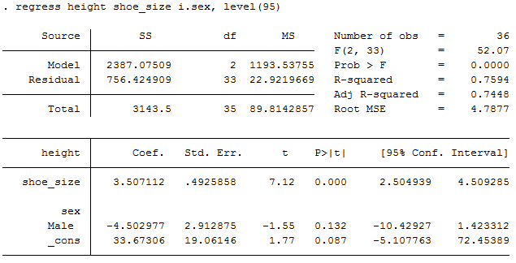


Example: Height and shoe size, cont.
$${\hat{β}}_{1}$$
$${\hat{β}}_{2}$$
$$\hat{α}$$

Slide 12
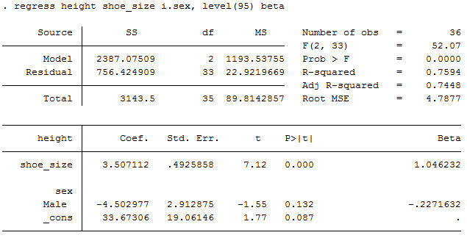


Example: Height and shoe size, cont.
$$β_{1}^{∗}=\frac{s_{x_{1}}}{s_{y}}×β_{1}$$
$$β_{2}^{∗}=\frac{s_{x_{2}}}{s_{y}}×β_{2}$$

Slide 13
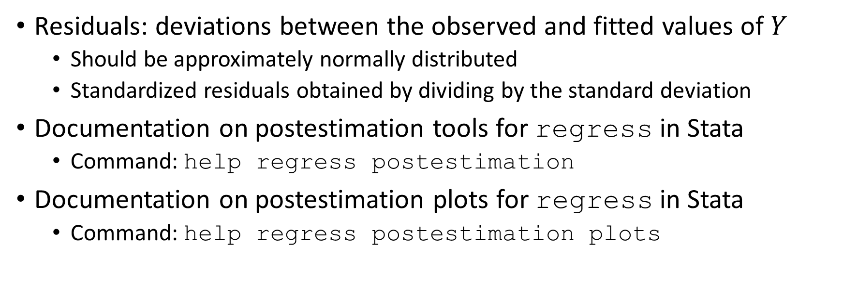
Residual analysis
Residuals: deviations between the observed and fitted values of $Y$
  Should be approximately normally distributed
  Standardized residuals obtained by dividing by the standard deviation
Documentation on postestimation tools for regress in Stata
  Command: help regress postestimation
Documentation on postestimation plots for regress in Stata
  Command: help regress postestimation plots

Slide 14
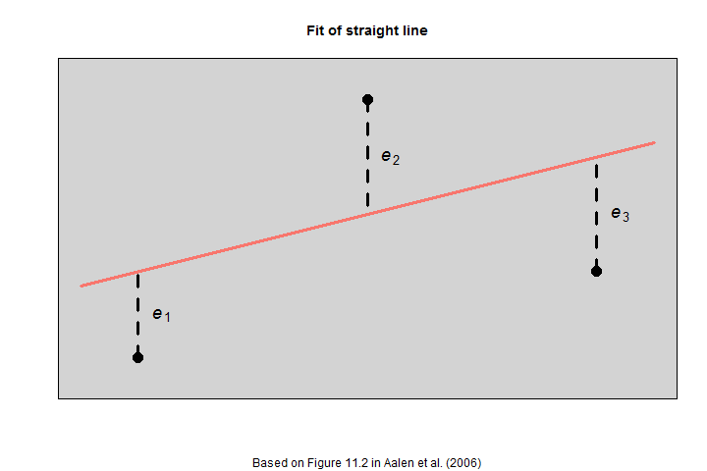
Residual analysis, cont.

Slide 15
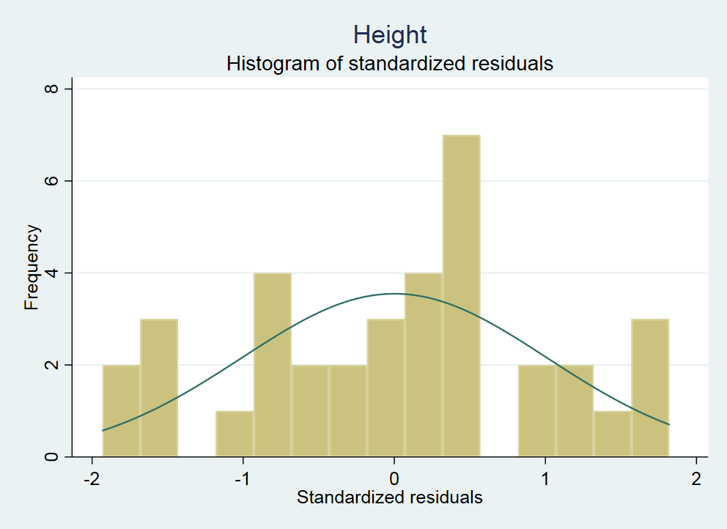
Example: Height and shoe size, cont.

Slide 16
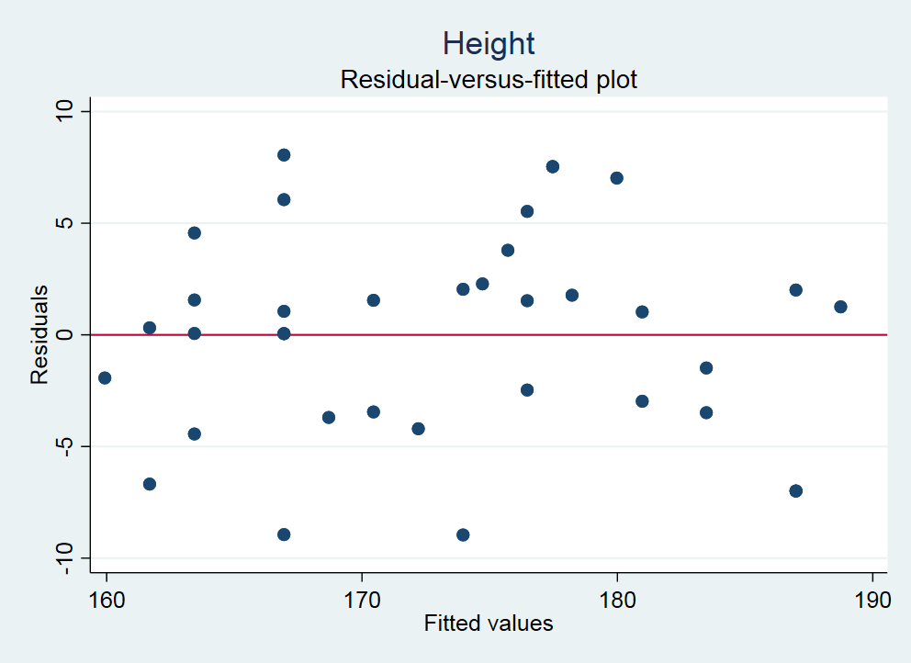
Example: Height and shoe size, cont.

Slide 17
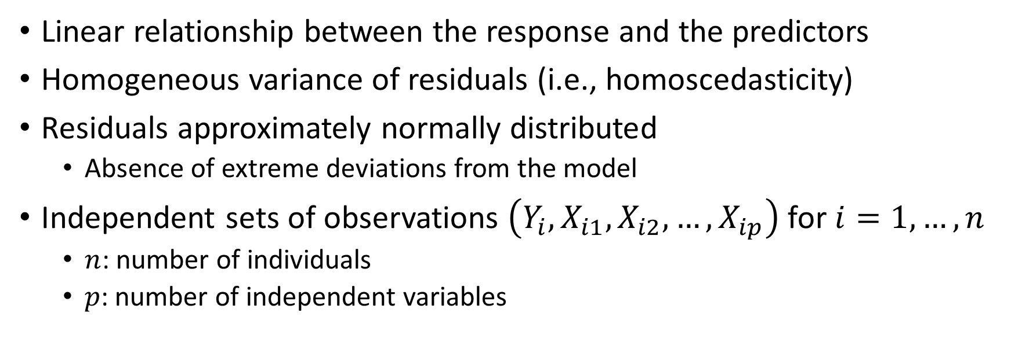
Assumptions
Linear relationship between the response and the predictors
Homogeneous variance of residuals (i.e., homoscedasticity)
Residuals approximately normally distributed
  Absence of extreme deviations from the model
Independent sets of observations $\left(Y_{i},X_{i1},X_{i2},…,X_{ip}\right)$ for $i=1,…,n$
  $n$: number of individuals
  $p$: number of independent variables

Slide 18
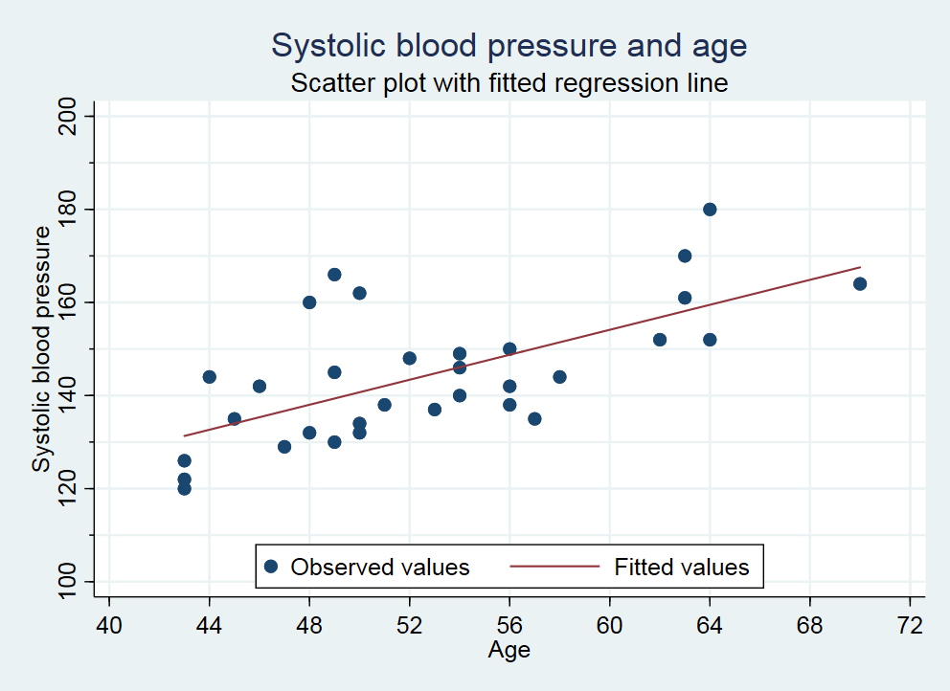
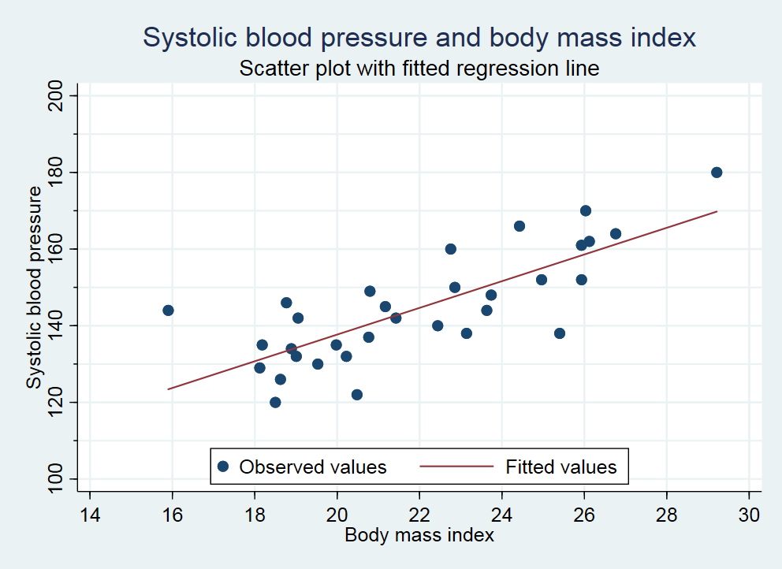
Example: Systolic blood pressure
Data from the file “sbp” used in Chapter 3 of Laake et al. (2007)

Slide 19
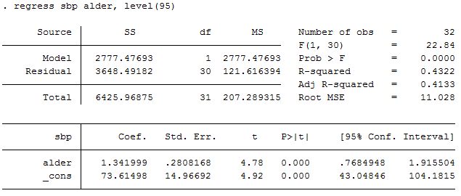
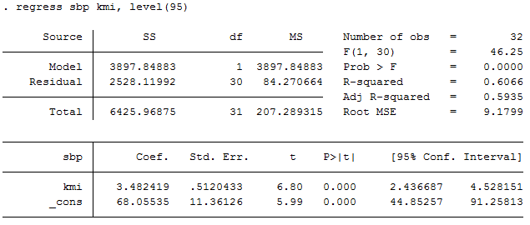
Example: Systolic blood pressure, cont.
Data from the file “sbp” used in Chapter 3 of Laake et al. (2007)

Slide 20
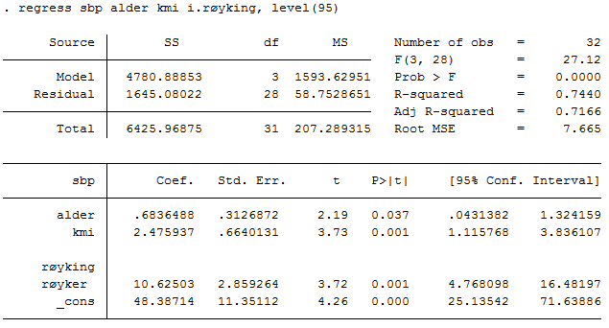
Example: Systolic blood pressure, cont.
Data from the file “sbp” used in Chapter 3 of Laake et al. (2007)

Slide 21
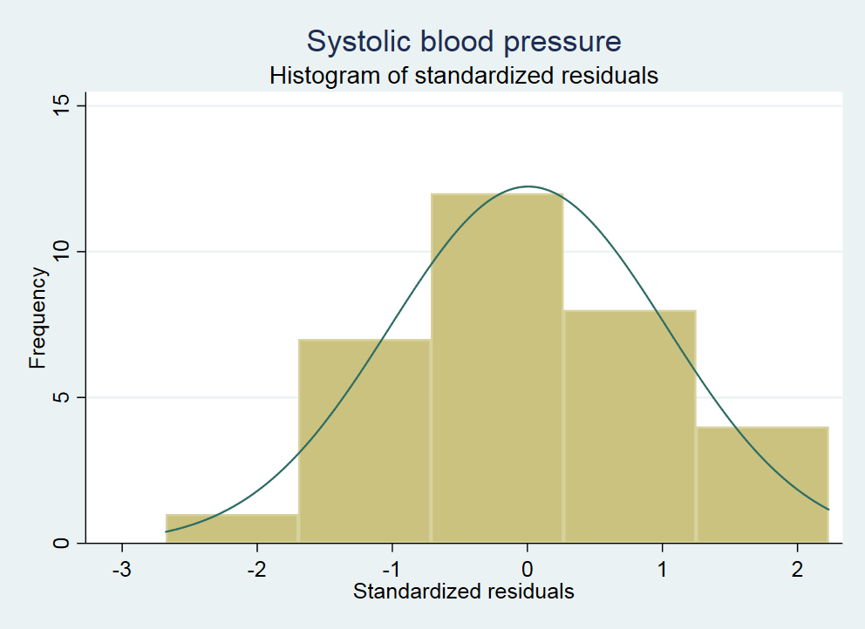
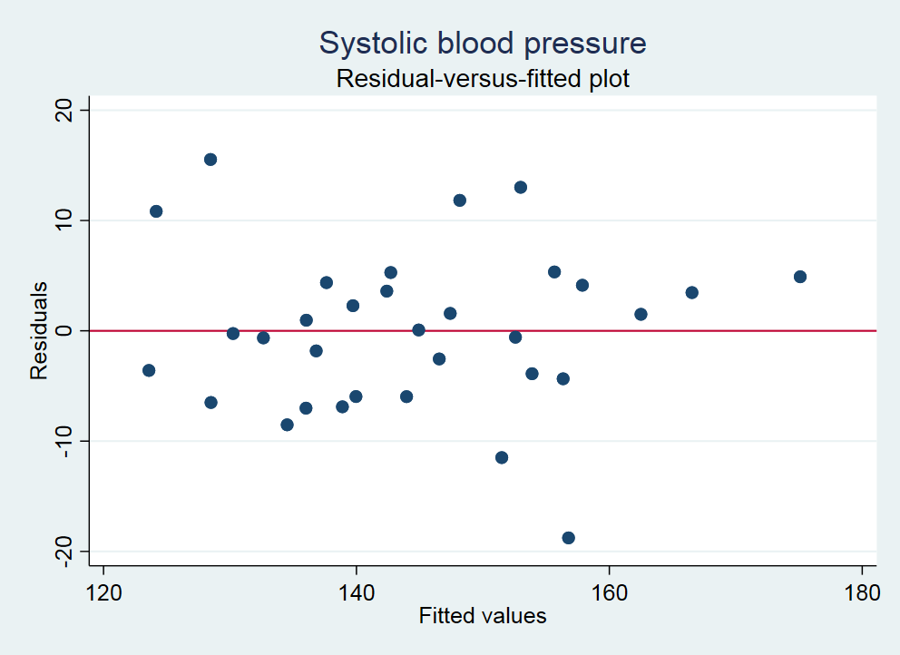
Example: Systolic blood pressure, cont.
Data from the file “sbp” used in Chapter 3 of Laake et al. (2007)

Slide 22
References
Aalen OO, Frigessi A, Moger TA, Scheel I, Skovlund E, Veierød MB. Statistiske metoder i medisin og helsefag. Oslo: Gyldendal akademisk; 2006.
Hemken D. Getting Centered and Standardized Coefficients Right. University of Wisconsin – Madison. https://www.ssc.wisc.edu/~hemken/Stataworkshops/stdBeta/docs/Getting%20Standardized%20Coefficients%20Right.pdf. Accessed November 17, 2020.
Laake P, Hjartåker A, Thelle DS, Veierød MB. Epidemiologiske og kliniske forskningsmetoder. Oslo: Gyldendal akademisk; 2007. https://www.med.uio.no/imb/forskning/publikasjoner/boker/2007/epidemiolgiske-kliniske-forskningsmetoder.html.

